Slide 1
Mathematics
Session 8: First Degree Equations
Haarlem
Peter Stikker
Notes:
Slides created by P. Stikker.
Version: 16 July 2019

Slide 2
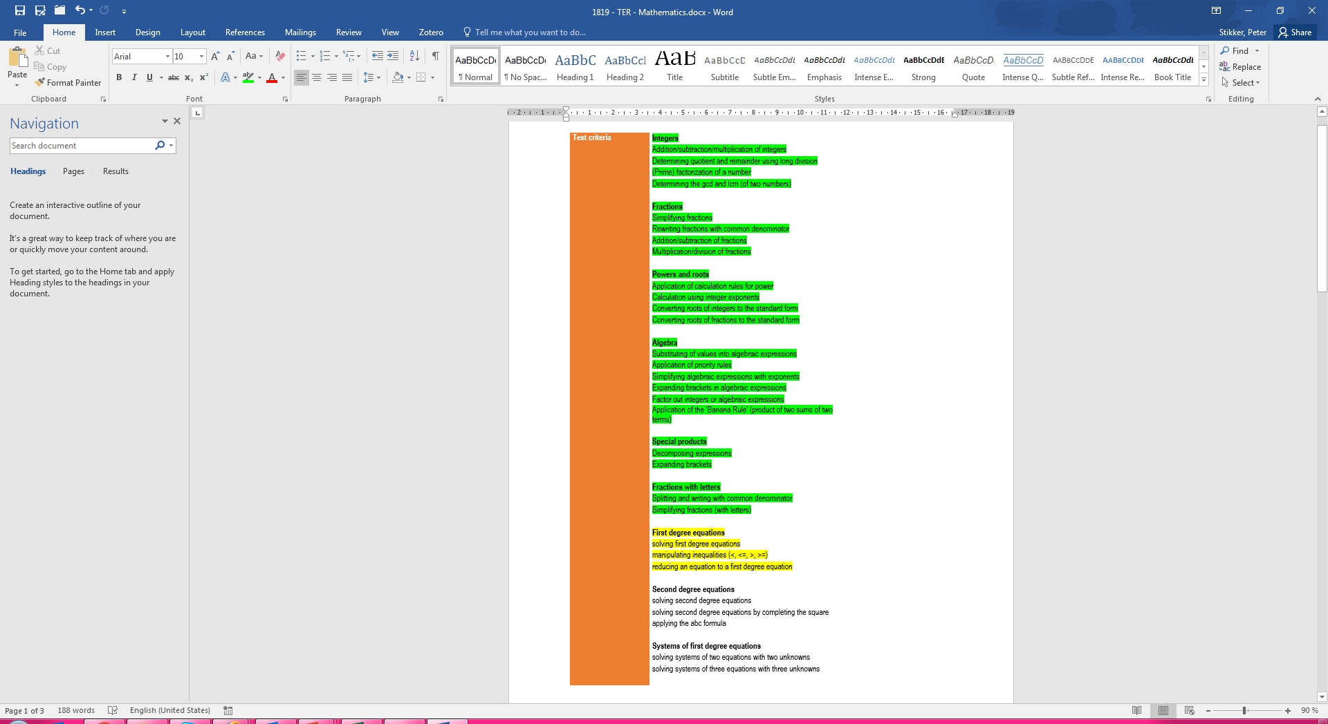
Today
Solving first degree equations
Solving inequalities
Rewrite into a first degree equation

Slide 3
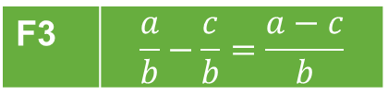
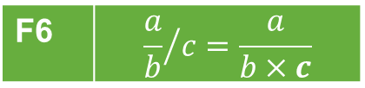


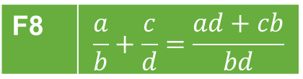

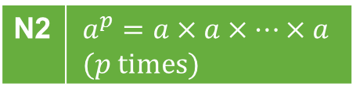

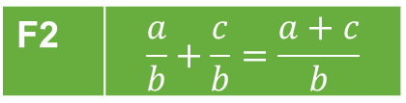
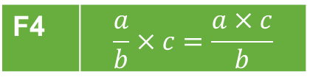

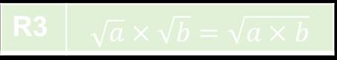











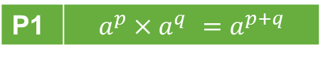

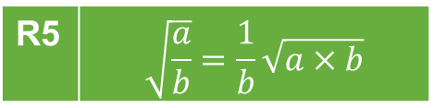



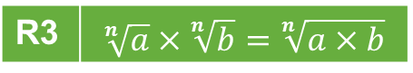
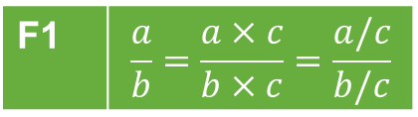
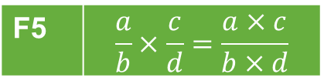
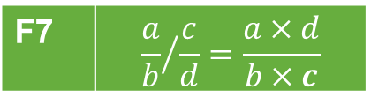

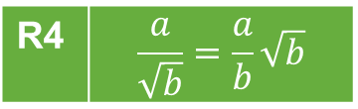


Overview so far…
Power rules
Fraction rules
Notation rules
P1 | $$a^{p}×a^{q} =a^{p+q}$$
F1 | $$\frac{a}{b}=\frac{a×c}{b×c}=\frac{a/c}{b/c}$$
F5 | $$\frac{a}{b}×\frac{c}{d}=\frac{a×c}{b×d}$$
N1 | $$\frac{a}{b}=a/b=a:b$$
P2 | $$a^{p}:a^{q}=a^{p−q}$$
F2 | $$\frac{a}{b}+\frac{c}{b}=\frac{a+c}{b}$$
F6 | $${\frac{a}{b}}/c=\frac{a}{b×c}$$
N2 | $$a^{p}=a×a×…×a \\ (p \text{times})$$
P3 | $${\left(a^{p}\right)}^{q} =a^{p×q}$$
P4 | $${\left(a×b\right)}^{p}=a^{p}×b^{p}$$
F3 | $$\frac{a}{b}−\frac{c}{b}=\frac{a−c}{b}$$
F7 | $${\frac{a}{b}}/{\frac{c}{d}}=\frac{a×d}{b×c}$$
N3 | $$a^{1}=a$$
P5 | $${\left(\frac{a}{b}\right)}^{p}=\frac{a^{p}}{b^{p}}$$
N4 | $$a×b=a∙b=ab$$
F4 | $$\frac{a}{b}×c=\frac{a×c}{b}$$
F8 | $$\frac{a}{b}+\frac{c}{d}=\frac{ad+cb}{bd}$$
N5 | $$\sqrt{a}=\sqrt[2]{a}$$
P6 | $$a^{−p}=\frac{1}{a^{p}}$$
Basic rules
Root rules
Brackets rules
B1 | $$\frac{a}{1}=a$$
R1 | $$\sqrt{a^{2}}=a$$
R1 | $$\sqrt[n]{a^{n}}=a$$
Br1 | $$a\left(b+c\right)=ab+ac$$
R2 | $${\left(\sqrt[n]{a}\right)}^{n}=a$$
B2 | $$\frac{a}{a}=1$$
R2 | $${\left(\sqrt{a}\right)}^{2}=a$$
Br2 | $$\left(a+b\right)\left(c+d\right)=ac+ad+bc+bd$$
R3 | $$\sqrt[n]{a}×\sqrt[n]{b}=\sqrt[n]{a×b}$$
R3 | $$\sqrt{a}×\sqrt{b}=\sqrt{a×b}$$
Br3 | $${\left(a+b\right)}^{2}=a^{2}+2ab+b^{2}$$
B3 | $$a×1=a$$
R4 | $$\frac{a}{\sqrt{b}}=\frac{a}{b}\sqrt{b}$$
Br4 | $${\left(a−b\right)}^{2}=a^{2}−2ab+b^{2}$$
B4 | $$a×b=b×a$$
B5 | $$a+b=b+a$$
R5 | $$\sqrt{\frac{a}{b}}=\frac{1}{b}\sqrt{a×b}$$
Br5 | $$\left(a+b\right)\left(a−b\right)=a^{2}−b^{2}$$

Slide 4
Segment 1: First degree equations

Slide 5
Equation
Equation setting two expressions equal to each other
Example: Expression 1: x + 7 Expression 2: 10 Equation : x + 7 = 10
Linear equation (1st degree equation): Equation where the highest power of the unknown(s) is 1

Slide 6
Solving equations
Remember: = means equal, so as long as you do the same thing on both sides, everything should remain in balance
Rules of the game:
1) You can add or subtract the same expression (e.g. a number) on both sides
2) You can multiply or divide (except by zero) the entire expressions on each side by an expression

Slide 7
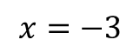
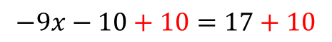
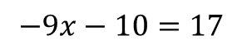
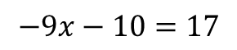
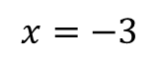
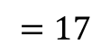
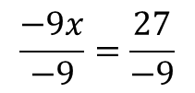
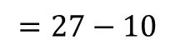
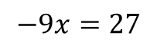
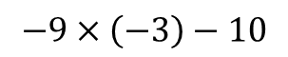
Example solving an equation
Rules of the game:
1) You can add or subtract the same expression (e.g. a number) on both sides
2) You can multiply or divide (except by zero) the entire expressions on each side by an expression
$$−9x−10=17$$
Add 10 to both sides
$$−9x−10+10=17+10$$
Simplify
$$−9x=27$$
Divide both sides by -9
$$\frac{−9x}{−9}=\frac{27}{−9}$$
Simplify
$$x=−3$$
Optional: Check your answer using substitution (session 5)
$$−9x−10=17$$
$$−9×\left(−3\right)−10$$
$$=27−10$$
$$=17$$
$$x=−3$$

Slide 8
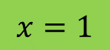
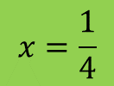
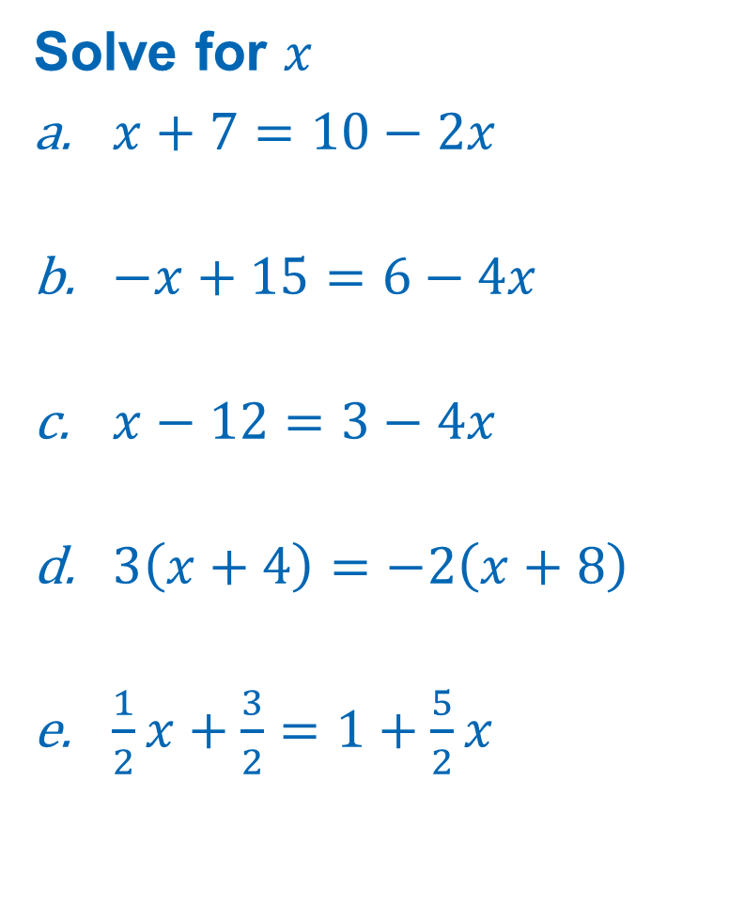
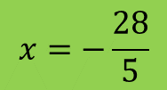
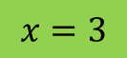
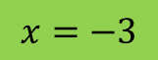
Practice 1
Solve for $x$
$x+7=10−2x$
$−x+15=6−4x$
$x−12=3−4x$
$3\left(x+4\right)=−2\left(x+8\right)$
$\frac{1}{2}x+\frac{3}{2}=1+\frac{5}{2}x$
Rules of the game:
You can add or subtract the same expression (e.g. a number) on both sides
You can multiply or divide (except by zero) the entire expressions on each side by an expression
$$x=1$$
$$x=−3$$
$$x=3$$
Tip:
First expand brackets
Place everything with an x on one side
Place everything without an x on the other side
$$x=−\frac{28}{5}$$
$$x=\frac{1}{4}$$

Slide 9
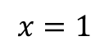
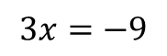
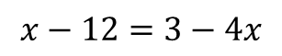
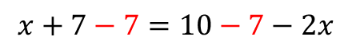
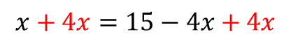
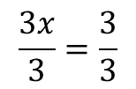
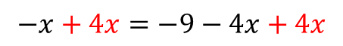
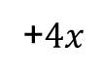
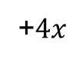
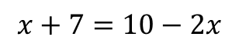
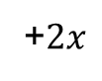
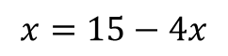
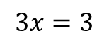
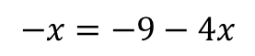
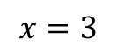
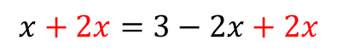
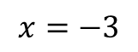
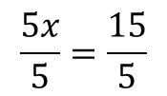
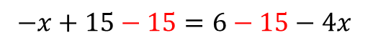





Expanded answers
$$x−12=3−4x$$
+12
$$x−12+12=3+12−4x$$
simplify
$$x=15−4x$$
+$4x$
$$x+7=10−2x$$
$$x+4x=15−4x+4x$$
-7
simplify
$$x+7−7=10−7−2x$$
$$5x=15$$
simplify
/5
$$x=3−2x$$
$$\frac{5x}{5}=\frac{15}{5}$$
$$x+2x=3−2x+2x$$
+$2x$
simplify
$$−x+15=6−4x$$
simplify
$$3x=3$$
-15
/3
$$−x+15−15=6−15−4x$$
$$x=3$$
$$\frac{3x}{3}=\frac{3}{3}$$
simplify
simplify
$$−x=−9−4x$$
+$4x$
$$x=1$$
$$−x+4x=−9−4x+4x$$
simplify
$$3x=−9$$
/3
$$\frac{3x}{3}=\frac{−9}{3}$$
simplify
$$x=−3$$

Slide 10


























Expanded answers
$$\frac{1}{2}x+\frac{3}{2}=1+\frac{5}{2}x$$
$$\frac{1}{2}x+\frac{3}{2}=1+\frac{5}{2}x$$
$$\frac{1}{2}x+\frac{3}{2}−\frac{3}{2}=1−\frac{3}{2}+\frac{5}{2}x$$
$$2\left(\frac{1}{2}x+\frac{3}{2}\right)=2\left(1+\frac{5}{2}x\right)$$
$$3\left(x+4\right)=−2\left(x+8\right)$$
$$\frac{1}{2}x=\frac{2}{2}−\frac{3}{2}+\frac{5}{2}x$$
$$3×x+3×4=−2×x+\left(−2\right)×8$$
$$x+3=2+5x$$
$$3x+12=−2x−16$$
$$\frac{1}{2}x=−\frac{1}{2}+\frac{5}{2}x$$
$$x+3−3=2−3+5x$$
$$3x+12−12=−2x−16−12$$
$$3x=−2x−28$$
$$\frac{1}{2}x−\frac{5}{2}x=−\frac{1}{2}+\frac{5}{2}x−\frac{5}{2}x$$
$$x=−1+5x$$
$$3x+2x=−2x+2x−28$$
$$x−5x=−1+5x−5x$$
$$5x=−28$$
$$−\frac{4}{2}x=−\frac{1}{2}$$
$$−4x=−1$$
$$\frac{5x}{5}=\frac{−28}{5}$$
$$\frac{−4x}{−4}=\frac{−1}{−4}$$
$$−2x=−\frac{1}{2}$$
$$x=−\frac{28}{5}$$
$$x=\frac{1}{4}$$
$$\frac{−2x}{−2}=\frac{−\frac{1}{2}}{−2}$$
$$x=\frac{1}{4}$$

Slide 11
Segment 2: Solving inequalities
Solving inequalities

Slide 12
Inequalities
An inequality is an equation but instead of ‘=‘ there is one or more of <, >, ≤, ≥
Less than <
Greater than >
Less than or equal to ≤
Greater than or equal to ≥
Rules
You can add or subtract the same expression (e.g. a number) on both sides
You can multiply or divide (except by zero) the entire expressions on each side by a positive expression
You can multiply or divide (except by zero) the entire expressions on each side by a negative expression, but will have to ‘flip’ the sign(s) then.

Slide 13









Example for inequality
Rules
You can add or subtract the same expression (e.g. a number) on both sides
You can multiply or divide (except by zero) the entire expressions on each side by a positive expression
You can multiply or divide (except by zero) the entire expressions on each side by a negative expression, but will have to ‘flip’ the sign(s) then.
$$−3x+5<x−3$$
-5
$$−3x+5−5<x−3−5$$
simplify
$$−3x<x−8$$
$$−x$$
$$−3x−x<x−x−8$$
simplify
$$−4x<−8$$
$$/−4$$
$$\frac{−4x}{−4}>\frac{−8}{−4}$$
simplify
$$x>2$$

Slide 14
Combined inequalities
Always write inequalities in the form of less than, or less than or equal to, with the unknown in the middle. So for example:
a < x < b
a ≤ x < b

Slide 15






Practice 2
$2x+6<x−8$
$−2x+6<x+9$
$\frac{1}{2}x+1<2−\frac{1}{2}x$
$−\frac{3}{2}x−1<2−\frac{1}{4}x$
$−3<−x+1<2$
$$x<−14$$
$$x>−1$$
$$x<1$$
$$x>−\frac{12}{5}$$
$$−1<x<4$$

Slide 16

















Practice 2: Worked out answers (1/2)
$$2x+6<x−8$$
– 6
$$\frac{1}{2}x+1<2−\frac{1}{2}x$$
$$2x<x−14$$
x 2
$$−x$$
$$x<−14$$
$$x+2<4−x$$
– 2
$$x<2−x$$
$$+x$$
$$−2x+6<x+9$$
$$2x<2$$
– 6
$$−2x<x+3$$
/ 2
$$\frac{2x}{2}<\frac{2}{2}$$
$$−x$$
$$−3x<3$$
$$\frac{−3x}{−3}>\frac{3}{−3}$$
/ -3
$$x<1$$
$$x>−1$$

Slide 17

















Practice 2: Worked out answers (2/2)
$$−\frac{3}{2}x−1<2−\frac{1}{4}x$$
$$−3<−x+1<2$$
$$×4$$
$$−1$$
$$−6x−4<8−x$$
$$−4<−x<1$$
$$/−1$$
$$+4$$
$$\frac{−4}{−1}>\frac{−x}{−1}>\frac{1}{−1}$$
$$−6x<12−x$$
$$+x$$
$$−5x<12$$
$$/−5$$
$$4>x>−1$$
$$\frac{−5x}{−5}>\frac{12}{−5}$$
$$−1<x<4$$
$$x>−\frac{12}{5}$$

Slide 18
Segment 3: Rewriting into a first degree equation

Slide 19

Linear equation (= first degree equation)
Definition: Equation where the highest power of the unknown(s) is 1
Consequence: A linear equation in x, is an equation with unknown x which can always be written in the form: ax + b = 0, with a and b as known numbers and a ≠ 0.
Some linear equations might at first not look like this at all, but can be rewritten into a linear equation. For example: $$\frac{x+7}{−3x+8}=1$$
Or can be solved using the same techniques. For example: $${\left(2x+3\right)}^{4}=81$$

Slide 20















Situation 1: x in the denominator
Algorithm:
Multiply both sides by the denominator
Simplify
Solve for x
Check condition
$$\frac{x+7}{−3x+8}=2$$
$$×\left(−3x+8\right)$$
$$\frac{x+7}{−3x+8}×\left(−3x+8\right)=2×\left(−3x+8\right)$$
simplify*
$$x+7=−6x+16$$
$$−7$$
$$x=−6x+9$$
$$+6x$$
$$7x=9$$
$$/7$$
$$x=\frac{9}{7}=1\frac{2}{7}$$
CONDITION:
$$−3x+8≠0$$
$$−8$$
$$−3x≠−8$$
$$/−3$$
$$x≠−\frac{8}{3}=−2\frac{2}{3}$$
* See next slide for ALL steps

Slide 21
















ALL steps in the ‘simplify’ step
$$\frac{x+7}{−3x+8}×\left(−3x+8\right)=2×\left(−3x+8\right)$$
F4 | $$\frac{a}{b}×c=\frac{a×c}{b}$$
$$\frac{\left(x+7\right)×\left(−3x+8\right)}{−3x+8}=2×\left(−3x+8\right)$$
B4 | $$a×b=b×a$$
$$\frac{\left(−3x+8\right)×\left(x+7\right)}{−3x+8}=2×\left(−3x+8\right)$$
F4 | $$\frac{a}{b}×c=\frac{a×c}{b}$$
$$\frac{−3x+8}{−3x+8}×\left(x+7\right)=2×\left(−3x+8\right)$$
B2 | $$\frac{a}{a}=1$$
$$1×\left(x+7\right)=2×\left(−3x+8\right)$$
B4 | $$a×b=b×a$$
$$\left(x+7\right)×1=2×\left(−3x+8\right)$$
B3 | $$a×1=a$$
$$x+7=2×\left(−3x+8\right)$$
Br1 | $$a\left(b+c\right)=ab+ac$$
$$x+7=2×\left(−3\right)x+2×8$$
$$x+7=−6x+16$$

Slide 22














Reducing an n-th degree equation to a linear one…
$${\left(\text{Expression}\text{1}\right)}^{n}=\text{Expression}\text{2}$$
$$\text{Expression}\text{1}=\sqrt[n]{\text{Expression}\text{2}}$$
And if n is even also:
$$\text{Expression}\text{1}=−\sqrt[n]{\text{Expression}\text{2}}$$
Chapter. 3.
$${\left(2x+3\right)}^{4}=81$$
$$2x+3=\sqrt[4]{81}$$
$$2x+3=−\sqrt[4]{81}$$
$$2x+3=3$$
$$2x+3=−3$$
$$2x+3−3=3−3$$
$$2x+3−3=−3−3$$
$2x=$0
$$2x=−6$$
$x=$0
$$x=−3$$

Slide 23








Practice 3
Solve for $x$
$\frac{2x+1}{x}=−3$
$\frac{2x+3}{4x}=6$
${\left(1−x\right)}^{2}=25$
$$x=−\frac{1}{5}$$
${\left(2x+1\right)}^{2}=6$
${\left(3−2x\right)}^{4}=4$
$4{\left(x+1\right)}^{2}=25{\left(x−1\right)}^{2}$
$$x=−\frac{1}{2}−\frac{1}{2}\sqrt{6},x=−\frac{1}{2}+\frac{1}{2}\sqrt{6}$$
$$x=\frac{3}{2}−\frac{1}{2}\sqrt{2},x=\frac{3}{2}+\frac{1}{2}\sqrt{2}$$
$$x=\frac{3}{22}$$
$$x=\frac{3}{7},x=\frac{7}{3}$$
$$x=−4,x=6$$

Slide 24

















Answers
$$\frac{2x+1}{x}=−3$$
$$\frac{2x+1}{x}×x=−3×x$$
$$\frac{2x+1}{x}×x=−3×x$$
$$\frac{2x+1}{x}×\frac{x}{1}=−3×x$$
$$2x+1=−3x$$
$$\frac{\left(2x+1\right)×x}{x×1}=−3x$$
$$2x+1−1=−3x−1$$
$$\frac{\left(2x+1\right)×x}{1×x}=−3x$$
$$2x=−3x−1$$
$$2x+3x=−3x+3x−1$$
$$\frac{2x+1}{1}×\frac{x}{x}=−3x$$
$$5x=−1$$
$$\frac{5x}{5}=\frac{−1}{5}$$
$$\frac{2x+1}{1}×1=−3x$$
$$x=−\frac{1}{5}$$
$$\frac{2x+1}{1}=−3x$$
$$2x+1=−3x$$

Slide 25

















Answers
$$\frac{2x+3}{4x}=6$$
$$\frac{2x+3}{4x}×4x=6×4x$$
$$\frac{2x+3}{4x}×4x=6×4x$$
$$\frac{2x+3}{4x}×\frac{4x}{1}=24x$$
$$2x+3=24x$$
$$\frac{\left(2x+3\right)×4x}{4x×1}=24x$$
$$2x+3−3=24x−3$$
$$\frac{\left(2x+3\right)×4x}{1×4x}=24x$$
$$2x=24x−3$$
$$2x−24x=24x−24x−3$$
$$\frac{2x+3}{1}×\frac{4x}{4x}=24x$$
$$−22x=−3$$
$$\frac{−22x}{−22}=\frac{−3}{−22}$$
$$\frac{2x+3}{1}×1=24x$$
$$x=\frac{3}{22}$$
$$\frac{2x+3}{1}=24x$$
$$2x+3=24x$$

Slide 26














Answers
$${\left(1−x\right)}^{2}=25$$
$$\sqrt{{\left(1−x\right)}^{2}}=±\sqrt{25}$$
$$1−x=±\sqrt{5^{2}}$$
$$1−x=±5$$
$$1−1−x=−1±5$$
$$−x=−1±5$$
$$\frac{−x}{−1}=\frac{−1±5}{−1}$$
$$x=\frac{−1±5}{−1}$$
$$x=\frac{−1−5}{−1}$$
$$x=\frac{−1+5}{−1}$$
$$x=\frac{−6}{−1}$$
$$x=\frac{4}{−1}$$
$$x=6$$
$$x=−4$$

Slide 27














Answers
$${\left(2x+1\right)}^{2}=6$$
$$\sqrt{{\left(2x+1\right)}^{2}}=±\sqrt{6}$$
$$2x+1=±\sqrt{6}$$
$$2x+1=±\sqrt{6}$$
$$2x+1−1=−1±\sqrt{6}$$
$$2x=−1±\sqrt{6}$$
$$\frac{2x}{2}=\frac{−1±\sqrt{6}}{2}$$
$$x=\frac{−1±\sqrt{6}}{2}$$
$$x=\frac{−1−\sqrt{6}}{2}$$
$$x=\frac{−1+\sqrt{6}}{2}$$
$$x=−\frac{1}{2}−\frac{\sqrt{6}}{2}$$
$$x=−\frac{1}{2}+\frac{\sqrt{6}}{2}$$
$$x=−\frac{1}{2}−\frac{1}{2}\sqrt{6}$$
$$x=−\frac{1}{2}+\frac{1}{2}\sqrt{6}$$

Slide 28
















Answers
$${\left(3−2x\right)}^{4}=4$$
$${\left({\left(3−2x\right)}^{2}\right)}^{2}=2^{2}$$
$$\sqrt{{\left(3−2x\right)}^{2}}=±\sqrt{2^{2}}$$
$${\left(3−2x\right)}^{2}=±2$$
$$\sqrt{{\left(3−2x\right)}^{2}}=±\sqrt{±2}$$
$$3−2x=±\sqrt{2}$$
$$3−3−2x=−3±\sqrt{2}$$
$$−2x=−3±\sqrt{2}$$
$$\frac{−2x}{−2}=\frac{−3±\sqrt{2}}{−2}$$
$$x=\frac{−3±\sqrt{2}}{−2}$$
$$x=\frac{−3−\sqrt{2}}{−2}$$
$$x=\frac{−3+\sqrt{2}}{−2}$$
$$x=\frac{3}{2}+\frac{\sqrt{2}}{2}$$
$$x=\frac{3}{2}−\frac{\sqrt{2}}{2}$$
$$x=\frac{3}{2}+\frac{1}{2}\sqrt{2}$$
$$x=\frac{3}{2}−\frac{1}{2}\sqrt{2}$$

Slide 29

























Answers
$${4\left(x+1\right)}^{2}={25\left(x−1\right)}^{2}$$
$$2^{2}{\left(x+1\right)}^{2}=5^{2}{\left(x−1\right)}^{2}$$
$$\sqrt{{4\left(x+1\right)}^{2}}=±\sqrt{{25\left(x−1\right)}^{2}}$$
$${\left(2\left(x+1\right)\right)}^{2}={\left(5\left(x−1\right)\right)}^{2}$$
$$\sqrt{2^{2}{\left(x+1\right)}^{2}}=±\sqrt{5^{2}{\left(x−1\right)}^{2}}$$
$$\sqrt{{\left(2\left(x+1\right)\right)}^{2}}=±\sqrt{{\left(5\left(x−1\right)\right)}^{2}}$$
$$\sqrt{2^{2}}\sqrt{{\left(x+1\right)}^{2}}=±\sqrt{5^{2}}\sqrt{{\left(x−1\right)}^{2}}$$
$$2\left(x+1\right)=±5\left(x−1\right)$$
$$2x+2=±\left(5x−5\right)$$
$$2x+2=−\left(5x−5\right)$$
$$2x+2=+\left(5x−5\right)$$
$$2x+2=−5x+5$$
$$2x+2=5x−5$$
$$2x+2−2=−5x+5−2$$
$$2x+2−2=5x−5−2$$
$$2x=−5x+3$$
$$2x=5x−7$$
$$2x+5x=−5x+5x+3$$
$$2x−5x=5x−5x−7$$
$$7x=3$$
$$−3x=−7$$
$$\frac{7x}{7}=\frac{3}{7}$$
$$\frac{−3x}{−3}=\frac{−7}{−3}$$
$$x=\frac{3}{7}$$
$$x=\frac{7}{3}$$

Slide 30
Closure
Overview & H☺mew☹rk

Slide 31
















Bonus puzzle
$$x=y$$
Multiply both sides with $x$
$$x×x=y×x$$
simplify
$$x^{2}=yx$$
Subtract$y^{2}$ on both sides
$$x^{2}−y^{2}=yx−y^{2}$$
Rewrite
$$\left(x+y\right)\left(x−y\right)=y\left(x−y\right)$$
Divide both sides by $x−y$
$$\frac{\left(x+y\right)\left(x−y\right)}{x−y}=\frac{y\left(x−y\right)}{x−y}$$
simplify
$$x+y=y$$
Substitute from first step $x=y$
$$y+y=y$$
simplify
$$2y=y$$
Divide both sides by $y$
$$\frac{2y}{y}=\frac{y}{y}$$
simplify
$$2=1$$
What is going wrong here?

Slide 32

Overview so far…
Power rules
Fraction rules
Notation rules
P1 | $$a^{p}×a^{q} =a^{p+q}$$
F1 | $$\frac{a}{b}=\frac{a×c}{b×c}=\frac{a/c}{b/c}$$
F5 | $$\frac{a}{b}×\frac{c}{d}=\frac{a×c}{b×d}$$
N1 | $$\frac{a}{b}=a/b=a:b$$
P2 | $$a^{p}:a^{q}=a^{p−q}$$
F2 | $$\frac{a}{b}+\frac{c}{b}=\frac{a+c}{b}$$
F6 | $${\frac{a}{b}}/c=\frac{a}{b×c}$$
N2 | $$a^{p}=a×a×…×a \\ (p \text{times})$$
P3 | $${\left(a^{p}\right)}^{q} =a^{p×q}$$
P4 | $${\left(a×b\right)}^{p}=a^{p}×b^{p}$$
F3 | $$\frac{a}{b}−\frac{c}{b}=\frac{a−c}{b}$$
F7 | $${\frac{a}{b}}/{\frac{c}{d}}=\frac{a×d}{b×c}$$
N3 | $$a^{1}=a$$
P5 | $${\left(\frac{a}{b}\right)}^{p}=\frac{a^{p}}{b^{p}}$$
N4 | $$a×b=a∙b=ab$$
F4 | $$\frac{a}{b}×c=\frac{a×c}{b}$$
F8 | $$\frac{a}{b}+\frac{c}{d}=\frac{ad+cb}{bd}$$
N5 | $$\sqrt{a}=\sqrt[2]{a}$$
P6 | $$a^{−p}=\frac{1}{a^{p}}$$
Basic rules
Root rules
Brackets rules
B1 | $$\frac{a}{1}=a$$
R1 | $$\sqrt{a^{2}}=a$$
R1 | $$\sqrt[n]{a^{n}}=a$$
Br1 | $$a\left(b+c\right)=ab+ac$$
R2 | $${\left(\sqrt[n]{a}\right)}^{n}=a$$
B2 | $$\frac{a}{a}=1$$
R2 | $${\left(\sqrt{a}\right)}^{2}=a$$
Br2 | $$\left(a+b\right)\left(c+d\right)=ac+ad+bc+bd$$
R3 | $$\sqrt[n]{a}×\sqrt[n]{b}=\sqrt[n]{a×b}$$
R3 | $$\sqrt{a}×\sqrt{b}=\sqrt{a×b}$$
Br3 | $${\left(a+b\right)}^{2}=a^{2}+2ab+b^{2}$$
B3 | $$a×1=a$$
R4 | $$\frac{a}{\sqrt{b}}=\frac{a}{b}\sqrt{b}$$
Br4 | $${\left(a−b\right)}^{2}=a^{2}−2ab+b^{2}$$
B4 | $$a×b=b×a$$
B5 | $$a+b=b+a$$
R5 | $$\sqrt{\frac{a}{b}}=\frac{1}{b}\sqrt{a×b}$$
Br5 | $$\left(a+b\right)\left(a−b\right)=a^{2}−b^{2}$$

Slide 33
Algorithms
& Game Rules
Algorithms
A1: Prime factorization
A2: Divisors
A3: GCD
A4: LCM
A5: Simplify fraction
A6: LCD
A7: Simplify square root
A8: Common Denominator
A9: Simplify fraction with Letters
Game Rules
G1: Rules for equations
G2: Rules for inequalities

Slide 34

H☺me W☹rk
Chapter 9: pg. 72-77
Selected exercises: pg. 72: 9.1 ( a,c,e), 9.2 (a,c,e), 9.3 (a,c,e), 9.4 (a,c,e), 9.5 (a,c,e), 9.6 (a,c,e), 9.10 (a,c,e), 9.11 (a,c,e), 9.12 (a,b,c), 9.13 (a,b,c) pg.74: 9.14 (a,c,e), 9.15 (a,c,e), 9.18 (a,c,e), 9.20 (a,c,e) pg.76: 9.22 (a,c,e), 9.24 (a,c,e), 9.26 (a,c,e), 9.28 (a,c,e)

